Slide 1
Weekly Report (AI based motion control)
Jin Lexuan
27.08.2021

Slide 2
Literature review
Path Planning: Dijkstra, A-star, PRM(Probabilistic Road Map), RRT(Rapidly exploring Random Tree), RRT*
RRT:
An Improved Path Planning Algorithm for UAV Based on RRT*
J. Chen and J. Yu, "An Improved Path Planning Algorithm for UAV Based on RRT," 2021 4th International Conference on Advanced Electronic Materials, Computers and Software Engineering (AEMCSE), 2021, pp. 895-898, doi: 10.1109/AEMCSE51986.2021.00182.

Slide 3
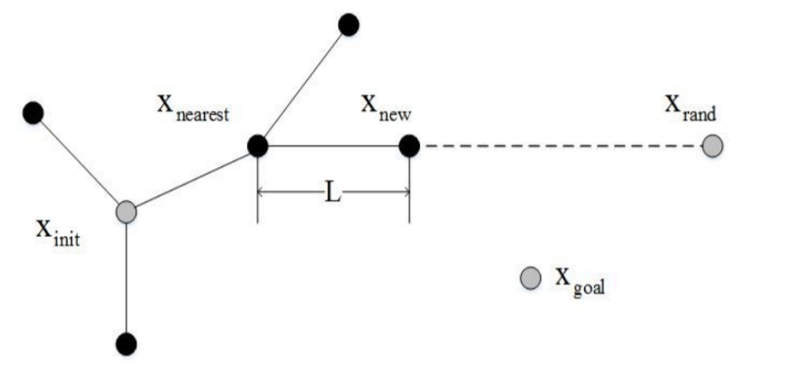
An Improved Path Planning Algorithm for UAV Based on RRT*
Three algorithms: Basic RRT Algorithm, RRT* Algorithm, improved RRT* algorithm
1.The starting point is set as the root node of the tree. The target node needs to be confirmed as well.
2.A new point will be sample randomly in the free space. However, the new point sometimes is not next node of the tree. The next node will be chosen on the line between the node of the tree which is the nearest node of the random point and the new point.
3. There will be a random number which is between 0 and 1 generated. It will be used to multiply the distance to get a new distance. The new distance will be the position of the new node on the line.
Schematic diagram of random tree growth of RRT algorithm

Slide 4
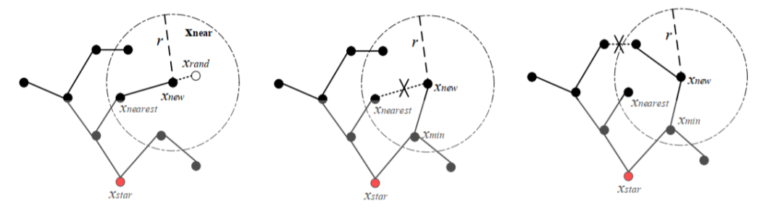
RRT* algorithm
The RRT* algorithm extends the schematic
The optimization process is added in the random tree expansion. The algorithm not only adds the new node acquired through sampling to the tree, but also searches whether there is a new parent node among the tree nodes contained in the circular neighborhood range that is a certain distance from the new node. If the new node can get a path with a lower cost after connecting with the parent node, the new node will be reconnected with the parent node. In addition, search for other tree nodes in the circular neighborhood. If the path cost of the tree node after connecting the new node as the parent node is lower than its previous path cost, then reconnect the random tree.

Slide 5
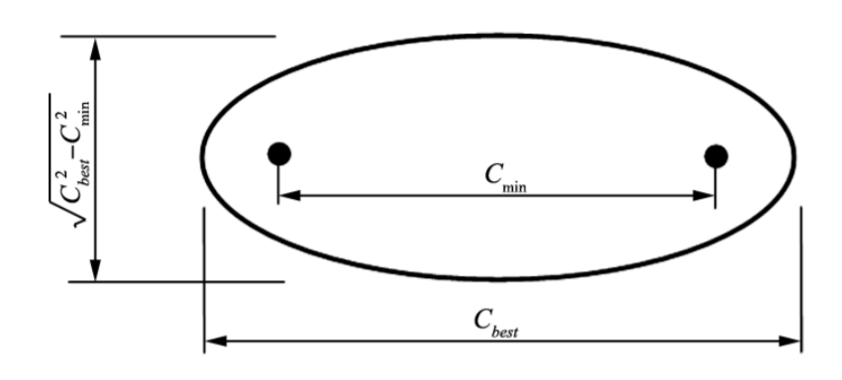
improved RRT* algorithm
2. Biased sampling around the generated path
The algorithm constructs the elliptic state subset space by finding the cost of the optimal path at the initial point, the target point and the current iteration process. After finding a feasible initial path, the starting point and target become two focal points respectively. The two focal points, long axis and short axis is to build an elliptical selection, then all the sampling points to fall inside the ellipse sampling space. Once a new more optimal path found, repeat the above, continuously sampling space narrow the interval of convergence when the ellipse to the line segment between two focus, which finds optimal path.
Improved sampling space of RRT* algorithm
1.Two random trees are extended from the initial point and the target point
At the same time, the first and last two trees expand towards each other. After each iteration, two trees repeat the steps interchangeably until the two trees join.

Slide 6
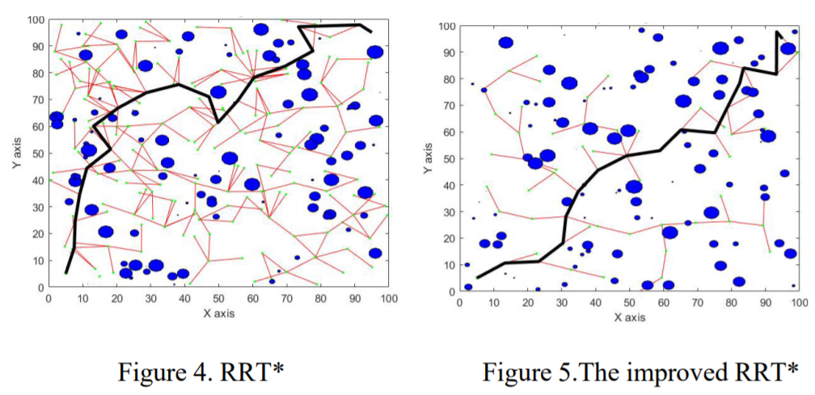
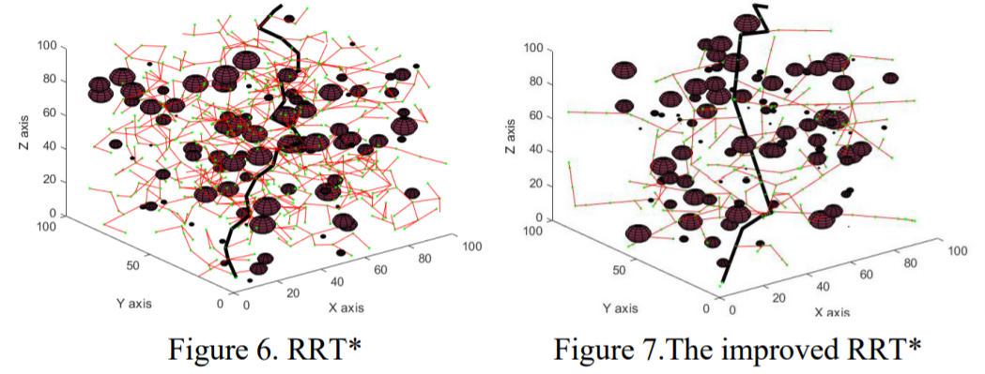
Simulation Results Comparison
In 2D environment
The improved RRT* - Connect algorithm has fewer iterations in complex environments and reduces the search of invalid areas, making the search more efficient and with stronger purpose.
In 3D environment
Compared with the traditional RRT* algorithm, it greatly reduces the path length and planning time, and improves the flight efficiency.

Slide 7
Future Work:
Literature Review:
RRT-Plan: a Randomized Algorithm for STRIPS Planning
Improved RRT-Connect Algorithm for Urban low-altitude UAV Route Planning
Robotic Path Planning: RRT and RRT*
Algorithm Studying:
Matlab: plannerRRT
https://www.mathworks.com/help/nav/ref/plannerrrt.html

Slide 8
Thank you for listening!

